Slide 1
Subquery in SQL

Slide 2
What is Subquery in SQL
A subquery is a SQL query within a query.
Subqueries are nested queries that provide data to the enclosing query.
Subqueries can return individual values or a list of records
Subqueries must be enclosed with parenthesis.
The subquery can be nested inside a SELECT, INSERT, UPDATE, or DELETE statement or inside another subquery.
A subquery is usually added within the WHERE Clause of another SQL SELECT statement.

Slide 3
You can use the comparison operators, such as >, <, or =.
The comparison operator can also be a multiple-row operator, such as IN, ANY, or ALL.

Slide 4
Where to use?
Compare an expression to the result of the query.
Determine if an expression is included in the results of the query.
Check whether the query selects any rows.

Slide 5

Syntax
The subquery (inner query) executes once before the main query (outer query) executes.
The main query (outer query) use the subquery result.

Slide 6
Example:
Student id | name | marks
1 | Roy | 66
2 | Joseph | 77
3 | Shreya | 88
4 | Roy | 95
5 | Alex | 99
Write an sql query to display the name of student who is getting maximum marks

Slide 7
Example:
Student id | name | marks
1 | Roy | 66
2 | Joseph | 77
3 | Shreya | 88
4 | Roy | 95
5 | Alex | 99
Write an sql query to display the name of student who is getting maximum marks
Select max(marks) from student;

Slide 8
Example:
Student id | name | marks
1 | Roy | 66
2 | Joseph | 77
3 | Shreya | 88
4 | Roy | 95
5 | Alex | 99
Write an sql query to display the name of student who is getting maximum marks
Select name from student where marks=(
Select max(marks) from student);

Slide 9
Example:
Student id | name | marks
1 | Roy | 66
2 | Joseph | 77
3 | Shreya | 88
4 | Roy | 95
5 | Alex | 99
Write an sql query to display the name of student who is getting second highest marks
Select max(marks) from student);

Slide 10
Example:
Student id | name | marks
1 | Roy | 66
2 | Joseph | 77
3 | Shreya | 88
4 | Roy | 95
5 | Alex | 99
Write an sql query to display the name of student who is getting second highest marks
Select max(marks) from student where marks<>(
Select max(marks) from student);

Slide 11
Example:
Student id | name | marks
1 | Roy | 66
2 | Joseph | 77
3 | Shreya | 88
4 | Roy | 95
5 | Alex | 99
Write an sql query to display the name of student who is getting second highest marks
Select name from student where marks=(
Select max(marks) from student where marks<>(
Select max(marks) from student));

Slide 12
Example
Create table student (student_id varchar(10),name varchar(10));
Create table marks (student_id varchar(10), tot_marks int);
Insert into student (student_id,name) values ('V001','Abe'), ('V002','Abhay'), ('V003', 'Acelin'), ('V004’, ‘Adelphos’);
Insert into marks (student_id,tot_marks) values ('V001',95), ('V002',80), ('V003', 74), ('V004',81);
student_id | name
V001 | Abe
V002 | Abhay
V003 | Acelin
V004 | Adelphos
student_id | tot_marks
V001 | 95
V002 | 80
V003 | 74
V004 | 81

Slide 13
Query:
Identify all students who get better marks than that of the student whose student_id is 'V002', but we do not know the marks of 'V002’.
Solution 1:
Step 1: Returns the marks (stored in tot_marks field) of 'V002’
SELECT * FROM marks WHERE student_id = 'V002’;
Step 2: Identifies the students who get better marks than the result of the first query.
SELECT a.student_id, a.name, b.tot_marks FROM student a, marks b WHERE a.student_id = b.student_id AND b.tot_marks >80;
Student_id | tot_marks
V002 | 80
student_id | name | tot_marks
V001 | Abe | 95
V004 | Adelphos | 81

Slide 14
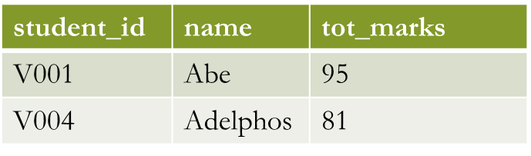
Query: Identify all students who get better marks than that of the student whose student_id is 'V002', but we do not know the marks of 'V002’.
Solution 2: With the help of sub query
SELECT a.student_id, a.name, b.tot_marksFROM student a, marks b
WHERE a.student_id = b.student_id AND b.tot_marks >
(SELECT tot_marks FROM marks WHERE student_id = 'V002');

Slide 15
Subqueries with INSERT statement
INSERT statement can be used with subqueries
Syntax:
INSERT INTO table_name [ (column1 [, column2 ]) ]
SELECT [ *|column1 [, column2 ]
FROM table1 [, table2 ]
[ WHERE VALUE OPERATOR ];

Slide 16

Subqueries with INSERT statement Example
If we want to insert those orders from 'orders' table which have the SHIPPERID from 3 to 5 into 'neworder' table the following SQL can be used:
INSERT INTO neworder
SELECT * FROM orders
WHERE SHIPPERID between 3 and 5;
select * from neworder;

Slide 17
Subqueries with UPDATE statement
In a UPDATE statement, you can set new column value equal to the result
returned by a single row subquery.
Syntax:
UPDATE table
SET column_name = new_value
[ WHERE OPERATOR [ VALUE ]
(SELECT COLUMN_NAME FROM TABLE_NAME) [ WHERE) ]

Slide 18
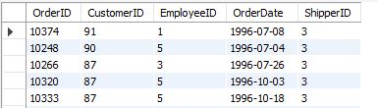
Subqueries with UPDATE statement Example
SELECT max(CustomerID) FROM orders
Output: 91
UPDATE neworder
SET OrderDate ='1996-07- 08’
WHERE CustomerID = (SELECT max(CustomerID) FROM orders);

Slide 19
Subqueries with DELETE statement
Syntax:
DELETE FROM TABLE_NAME
[ WHERE OPERATOR [ VALUE ]
(SELECT COLUMN_NAME
FROM TABLE_NAME) [ WHERE) ]
Example:
DELETE FROM neworder WHERE EmployeeID <
(SELECT avg(EmployeeID) FROM orders);

Slide 20
Type of Subqueries
Single row subquery : Returns zero or one row.
Multiple row subquery : Returns one or more rows.
Multiple column subqueries : Returns one or more columns.
Correlated subqueries : Reference one or more columns in the outer SQL statement. The subquery is known as a correlated subquery because the subquery is related to the outer SQL statement.
Nested subqueries : Subqueries are placed within another subquery.

Slide 21
Single Row Subqueries
A single row subquery returns zero or one row to the outer SQL statement.
You can place a subquery in a WHERE clause, a HAVING clause, or a FROM clause of a SELECT statement.

Slide 22
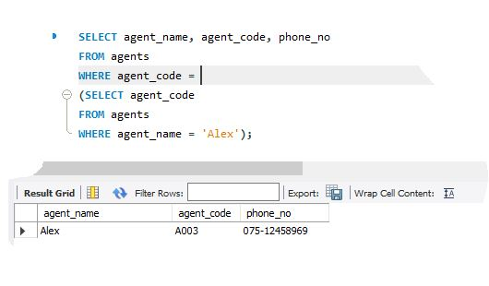
Single row subquery in a WHERE clause
SELECT agent_name, agent_code, phone_no
FROM agents
WHERE agent_code =
(SELECT agent_code FROM agentsWHERE agent_name = 'Alex');

Slide 23

Using comparison operators in Single Row subquery in where clause
SELECT ord_num,ord_amount,ord_date,cust_code, agent_code FROM orders
WHERE ord_amount < (SELECT AVG(ord_amount) FROM orders);

Slide 24
Single row subqueries in a HAVING clause
HAVING clause is used to filter groups of rows.
You may place a subquery in HAVING clause in an outer query.
This allows you to filter groups of rows based on the result returned by your subquery.

Slide 25

Single row subqueries in a HAVING clause example
SELECT AVG(ord_amount),COUNT(agent_code),agent_code
FROM orders
GROUP BY agent_code
HAVING AVG(ord_amount)= (SELECT AVG(ord_amount) FROM orders WHERE agent_code='A008');

Slide 26
Multiple row subquery
Multiple row subquery returns one or more rows to the outer SQL statement.
You may use the IN, ANY, or ALL operator in outer query to handle a subquery that returns multiple rows

Slide 27

Using IN operator with a Multiple Row Subquery
IN operator is used to checking a value within a set of values.
SELECT ord_num,ord_amount,ord_date, cust_code, agent_code
FROM orders WHERE agent_code IN( SELECT agent_code FROM agents WHERE working_area='Bangalore');

Slide 28
Using any operator with a Multiple Row Subquery
You can use the ANY operator to compare a value with any value in a list.
You must place an =, <>, >, <, <= or >= operator before ANY in your query.

Slide 29

Using any operator with a Multiple Row Subquery example
SELECT agent_code, agent_name, working_area
FROM agents
WHERE agent_code= ANY(SELECT agent_code FROM customer WHERE cust_country = 'India’);

Slide 30

Multiple Column Subqueries
select ord_num, agent_code, ord_date, ord_amount
from orders where (agent_code, ord_amount)
IN(SELECT agent_code, MIN(ord_amount) FROM orders GROUP BY agent_code);

Slide 31
Correlated Subqueries
Correlated Subqueries are used to select data from a table referenced in the outer query.
The subquery is known as a correlated because the subquery is related to the outer query.
In this type of queries, a table alias (also called a correlation name) must be used to specify which table reference is to be used.

Slide 32
Correlated subquery example Contd…
Display the employee_id, manager_id, first_name and last_name of those employees who manage other employees.
SELECT employee_id, manager_id, first_name, last_name
FROM employees a
WHERE EXISTS (SELECT employee_id FROM employees b WHERE b.manager_id = a.employee_id)

Slide 33
Nested Subqueries
A subquery can be nested inside other subqueries.
SQL has an ability to nest queries within one another.
A subquery is a SELECT statement that is nested within another SELECT statement and which return intermediate results.
SQL executes innermost subquery first, then next level.

Slide 34

Nested subquery example
Retrieve job_id and its average salary from the employees table which have a salary is smaller than (averages of min_salary of job_id from the jobs table which job_id are in the list, picking from (the job_history table which is within the department_id 50 and 100)) (use hr database)
SELECT job_id, AVG(salary)
FROM employees GROUP BY job_id
HAVING AVG(salary)<
(SELECT AVG(min_salary) FROM jobs WHERE job_id IN
(SELECT job_id FROM job_history WHERE department_id BETWEEN 50 AND 100));

